Slide 1




RCC Subtype Salient Feature Discovery
A. Feltus, S. Niu, K. Matusow, W. Poehlman, B. Shealy, C. Shearer, C. Targonski, E. Weill

Slide 2
Pre-Hackathon

Slide 3
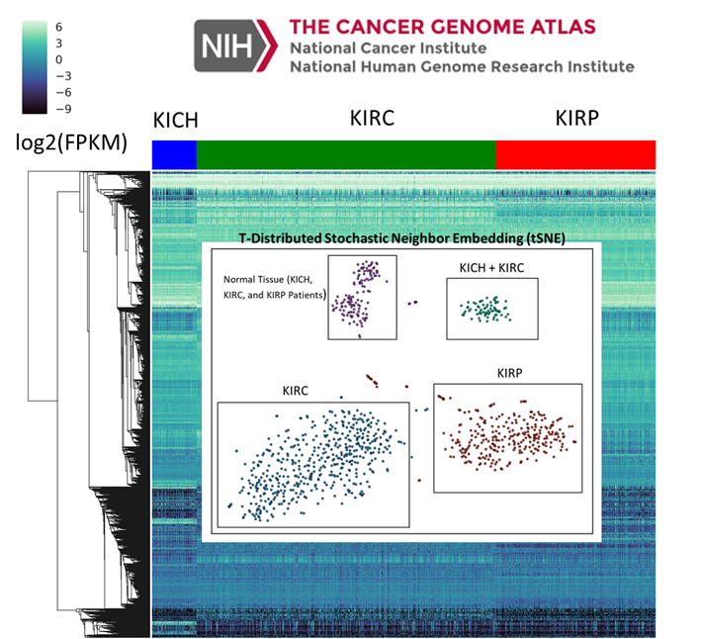
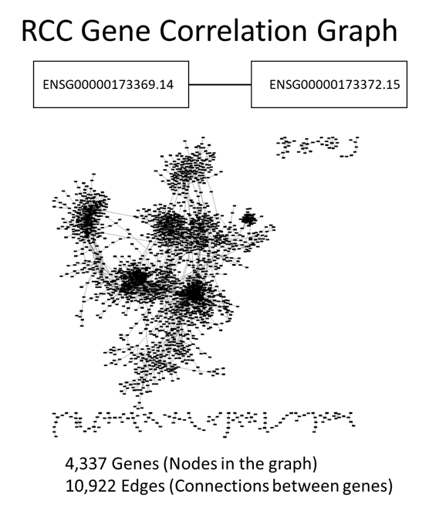
Notes:
{
"healthy":128,
"stage_i_kirc":272,
"stage_ii_kirc":59,
"stage_iii_kirc":123,
"stage_iv_kirc":82,
"stage_i_kirp":172,
"stage_ii_kirp":22,
"stage_iii_kirp":51,
"stage_iv_kirp":14,
"stage_i_kich":20,
"stage_ii_kich":25,
"stage_iii_kich":14,
"stage_iv_kich":6
}

Slide 4
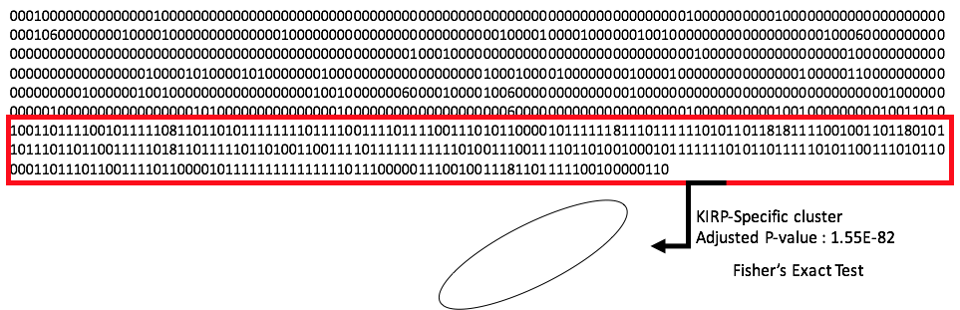
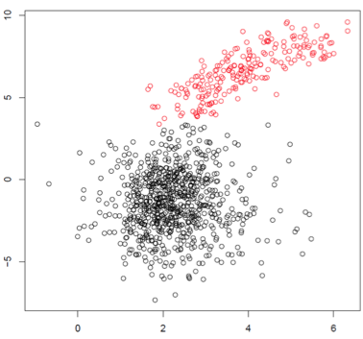

Slide 5
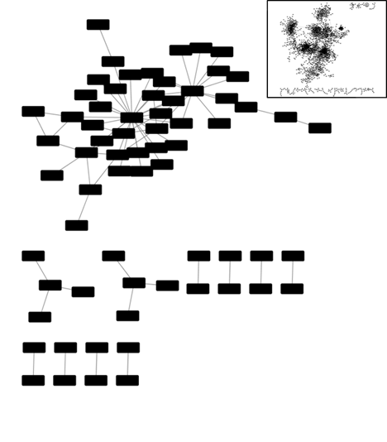
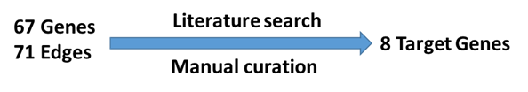

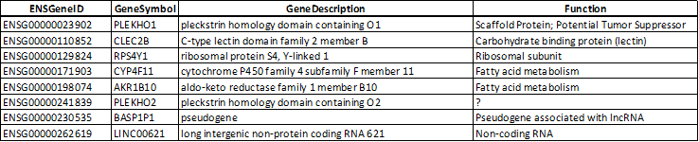
KIRP-Specific
Joint Biomarkers
Thanks to Matt Callahan for some super sleuthing!

Slide 6
SVAI Hackathon

Slide 7
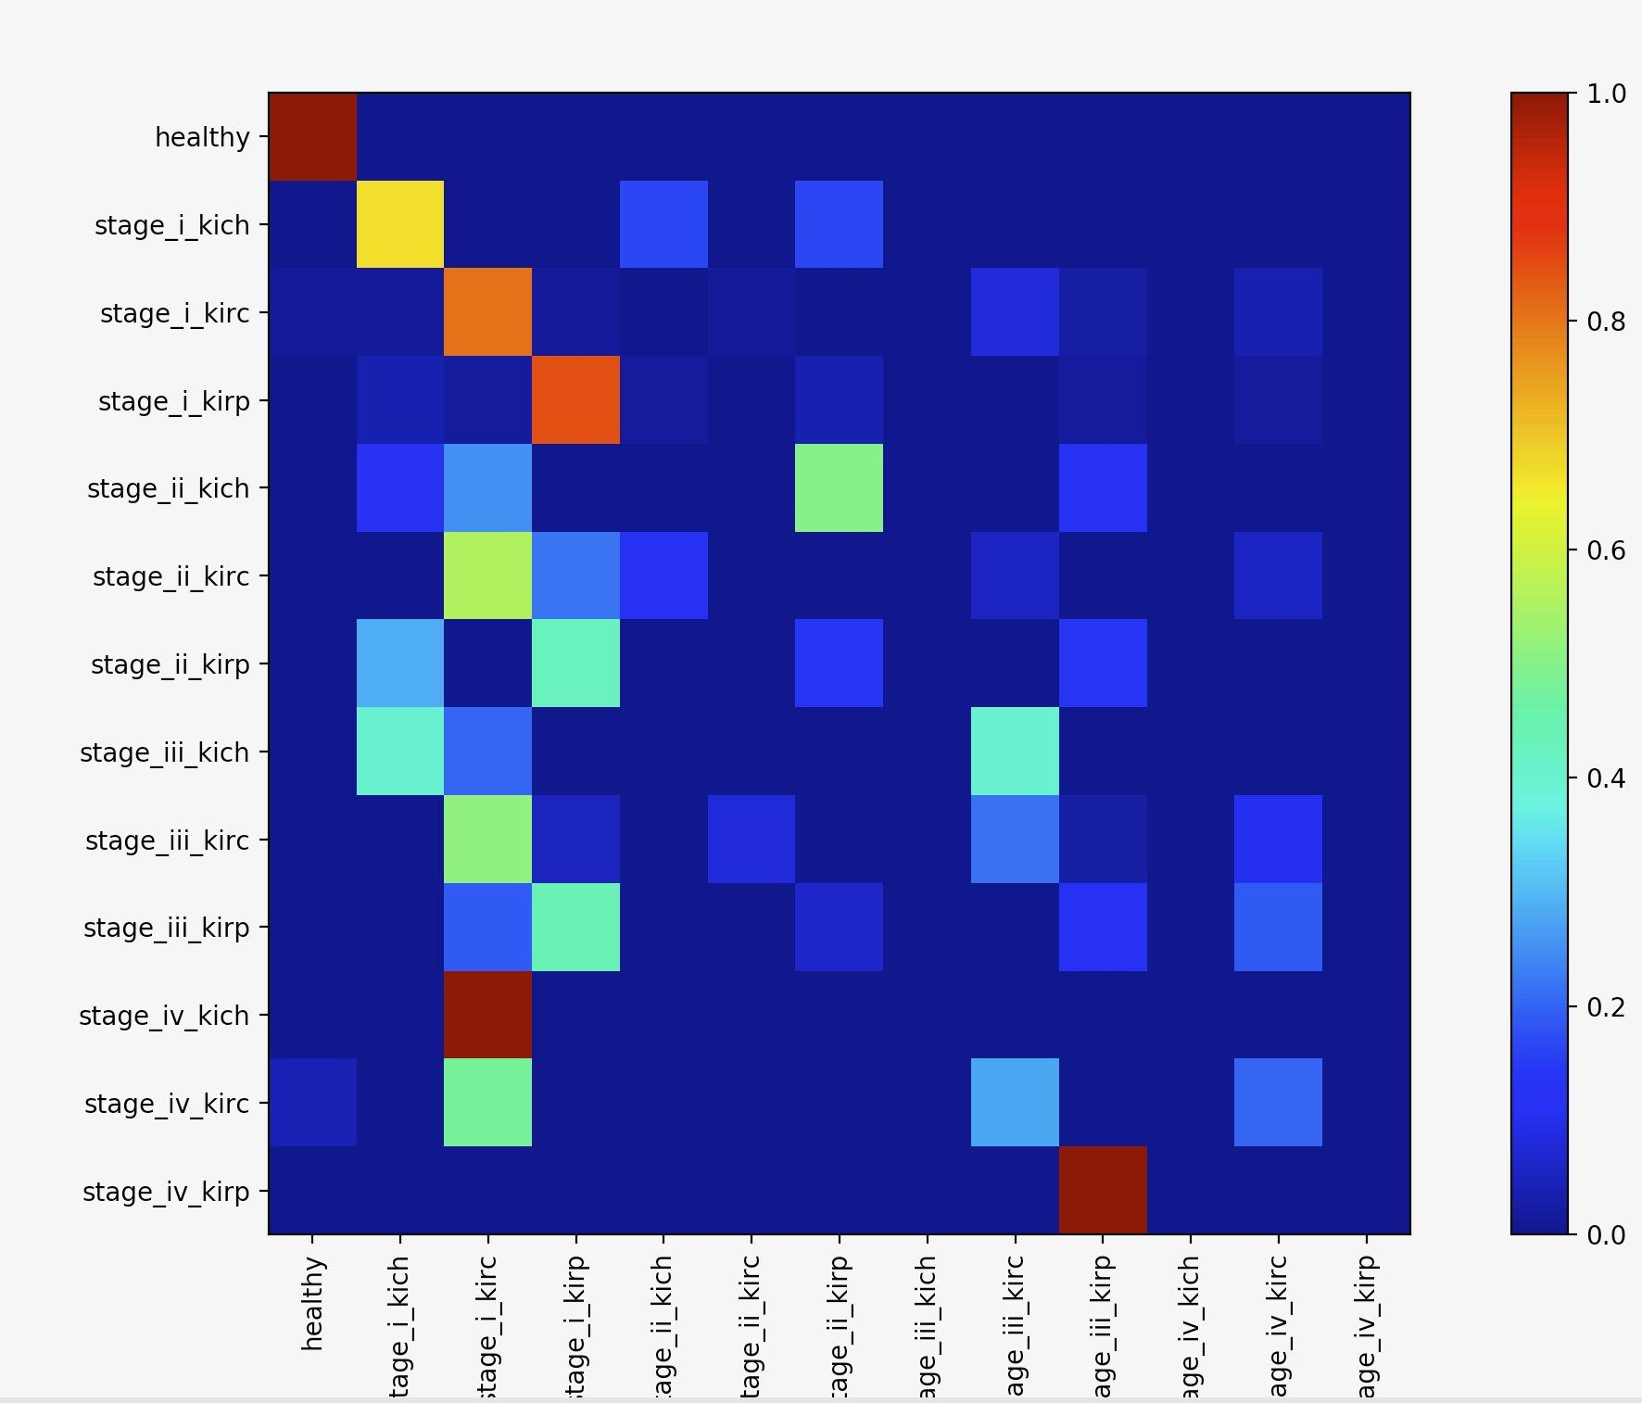
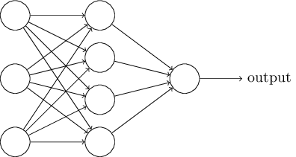

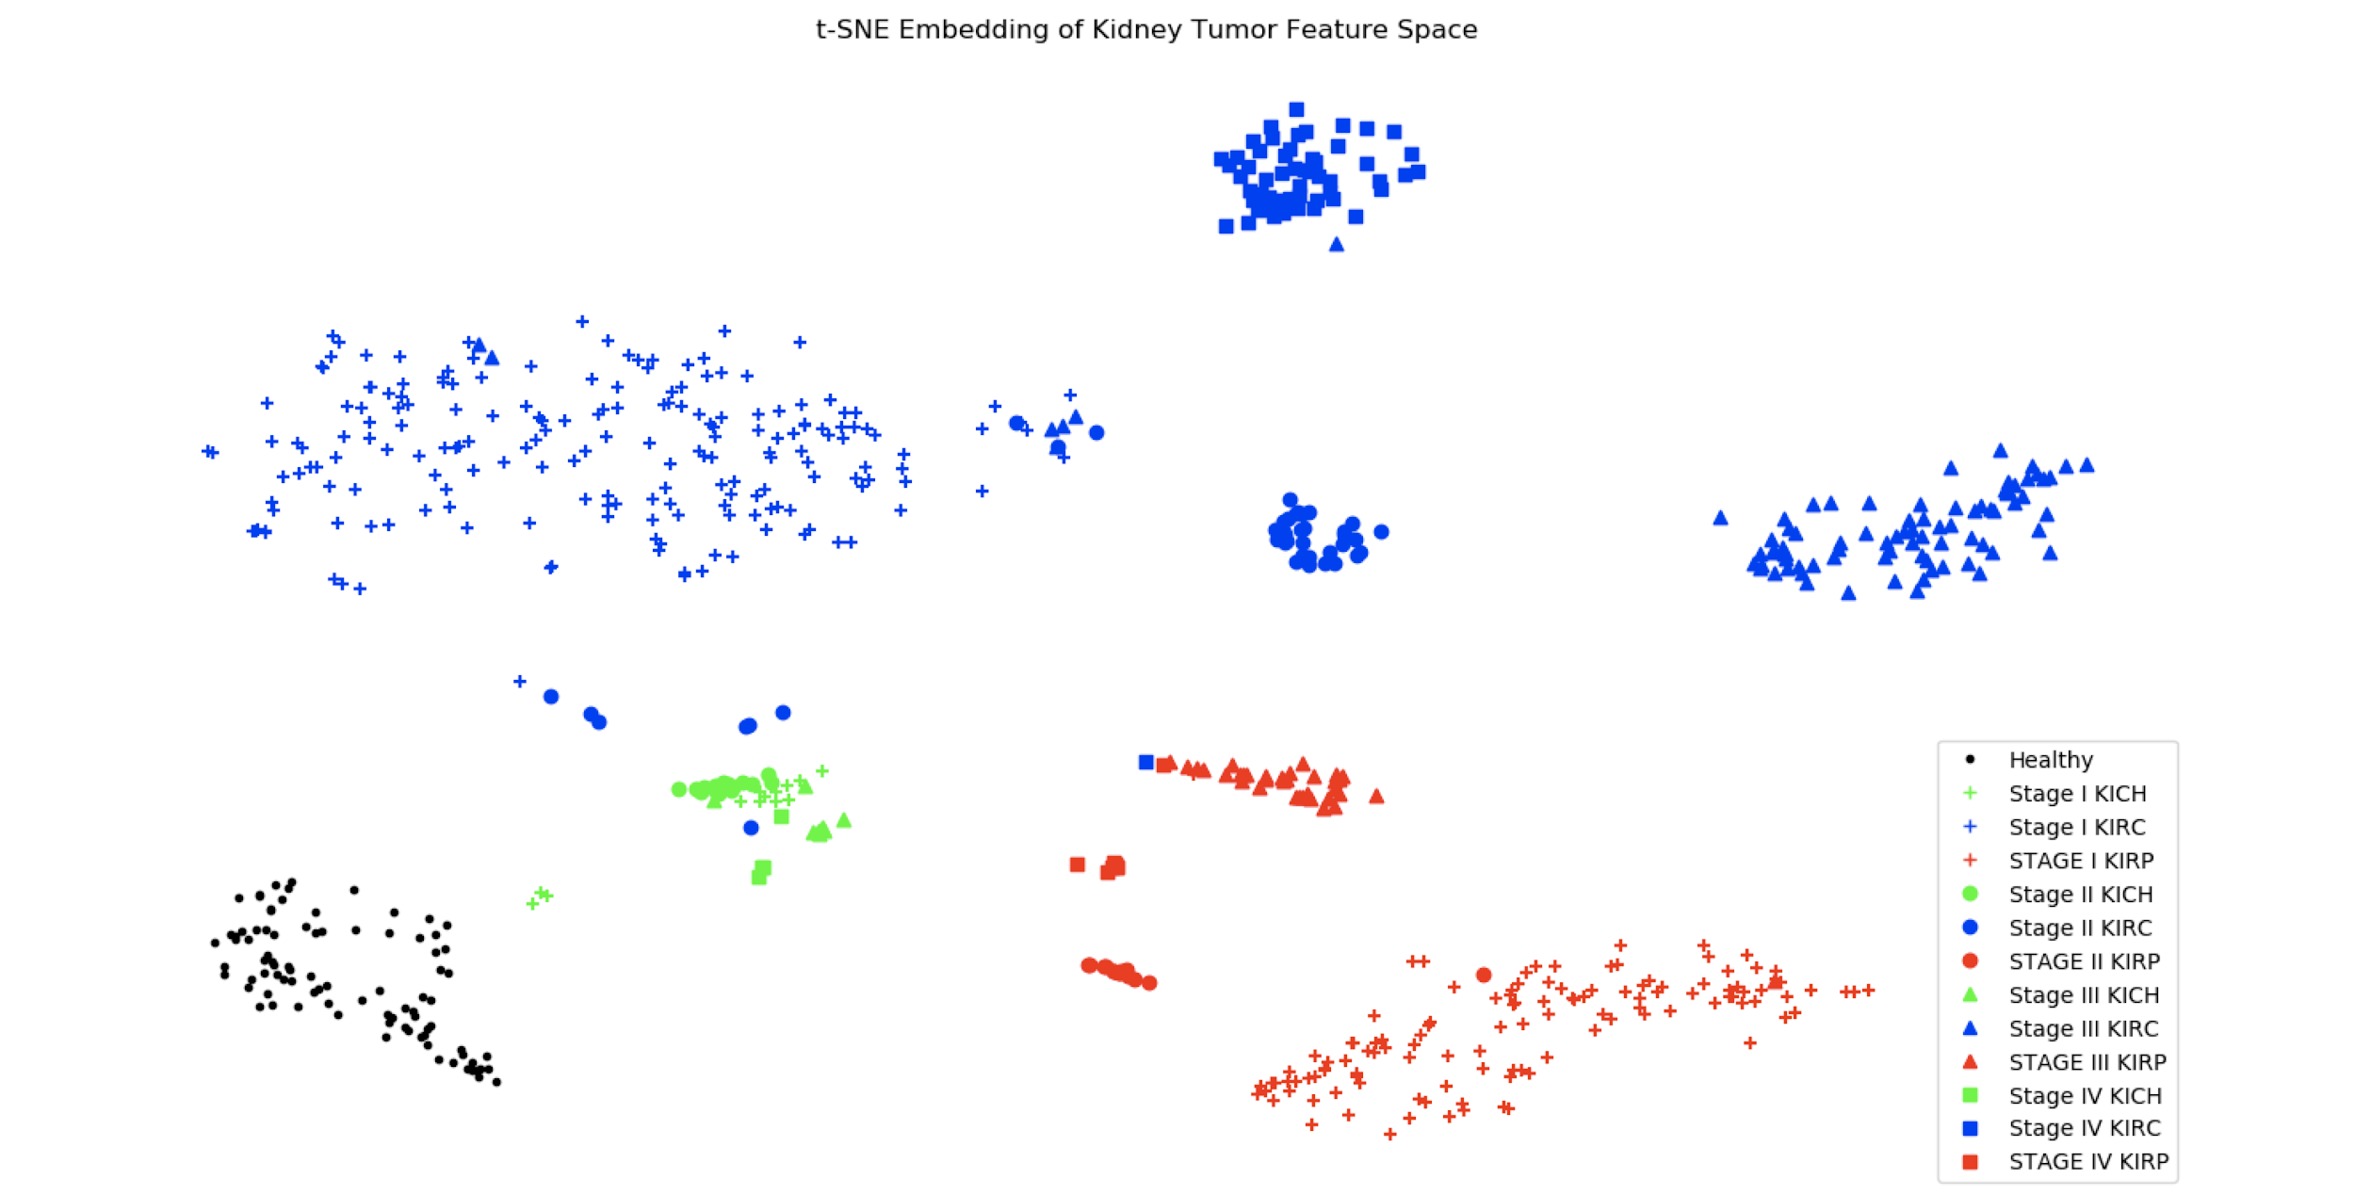
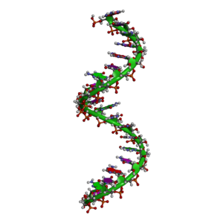
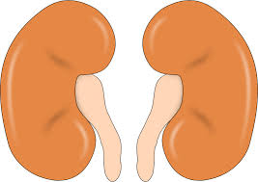
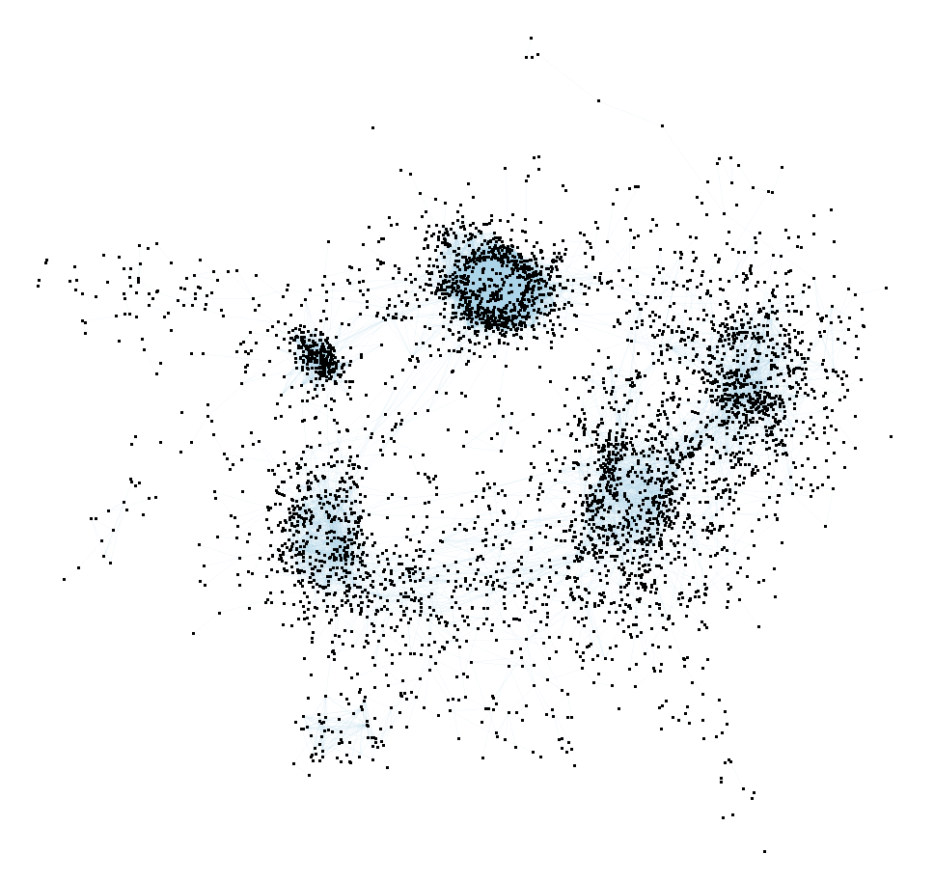
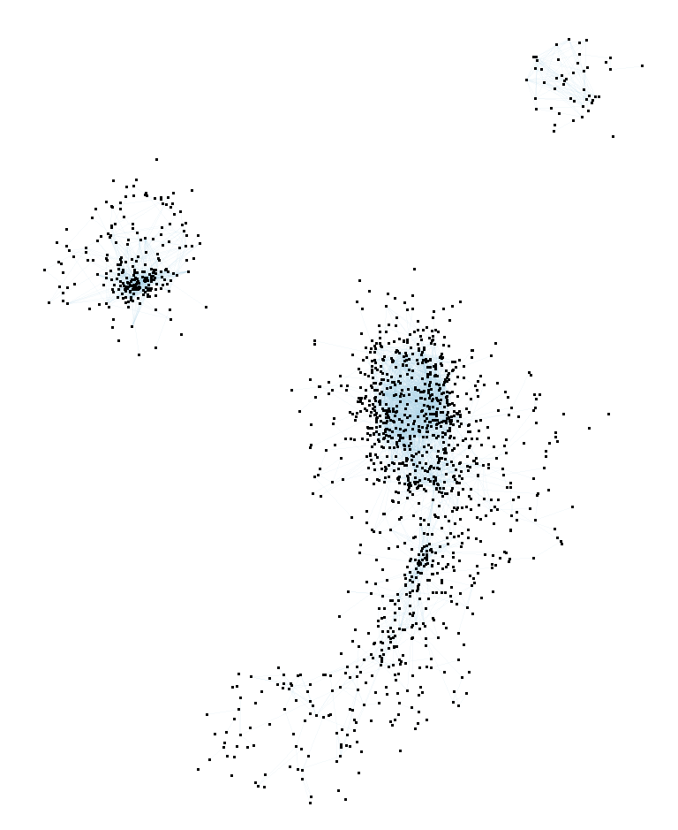
Research Workflow
Model TCGA-RCC tumors as a “time series” across stage (Normal, I, II, III, IV) for each subtype (KIRC, KIRP, KICH)
Evaluate ability of a neural network to discriminate across subtype and stage
Construct stage-specific co-expression networks
Identify shared gene interaction communities across each tumor stage
Classification
Subtype Networks
Kidney Sample
RNA
Data Processing

Slide 8
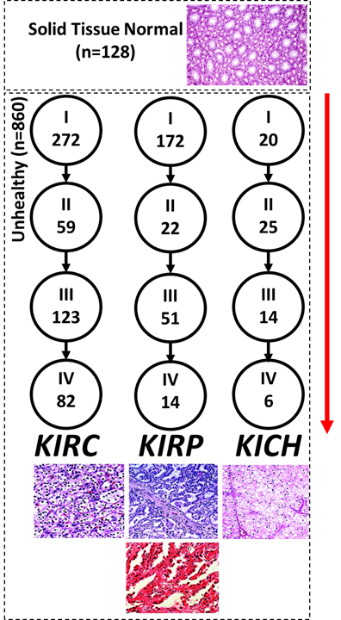

Notes:
{
"healthy":128,
"stage_i_kirc":272,
"stage_ii_kirc":59,
"stage_iii_kirc":123,
"stage_iv_kirc":82,
"stage_i_kirp":172,
"stage_ii_kirp":22,
"stage_iii_kirp":51,
"stage_iv_kirp":14,
"stage_i_kich":20,
"stage_ii_kich":25,
"stage_iii_kich":14,
"stage_iv_kich":6
}
*32 non reported tumor types

Slide 9
Notes:
{
"healthy":128,
"stage_i_kirc":272,
"stage_ii_kirc":59,
"stage_iii_kirc":123,
"stage_iv_kirc":82,
"stage_i_kirp":172,
"stage_ii_kirp":22,
"stage_iii_kirp":51,
"stage_iv_kirp":14,
"stage_i_kich":20,
"stage_ii_kich":25,
"stage_iii_kich":14,
"stage_iv_kich":6
}
*32 non reported tumor types

Slide 10
Solid Tissue Normal
KIRP (I)
Notes:
{
"healthy":128,
"stage_i_kirc":272,
"stage_ii_kirc":59,
"stage_iii_kirc":123,
"stage_iv_kirc":82,
"stage_i_kirp":172,
"stage_ii_kirp":22,
"stage_iii_kirp":51,
"stage_iv_kirp":14,
"stage_i_kich":20,
"stage_ii_kich":25,
"stage_iii_kich":14,
"stage_iv_kich":6
}
*32 non reported tumor types

Slide 11
Future Directions
Parse stage/RCC-subtype specific sub-networks
Fit PRCC staged subnetworks discovered to Dr. Hsieh’s circuit breaker model
Reduce genome to windows circumscribing known/emerging PRCC biomarker loci and discover individual patient mutations in these regions

